Slide 1
Investing in Health Systems: Insights into How Health Workforce Density Shapes UHC Density and Key Health Outcomes

Slide 2
Background
Health workforce density refers to the number of health care professionals, such as doctors, nurses, midwives, pharmacists, dentists, etc., available per unit of population where in our case the number is measured per 10,000 population.
Evidence from the World Health Organization (WHO) demonstrates that a minimum density of 44.5 doctors, nurses, and midwives per 10,000 population is essential to deliver essential health services and sustain progress toward UHC (World Health Organization, 2025).
Countries that reach or surpass this threshold consistently record service coverage indices above 70%, reflecting improved access, quality, and equity in care (Ahmat, Asamani, & Illou, 2022).
To understand whether equal distribution of health workers across cadres can suffice, the average observed proportion of health workers per 10,000 population for each cadre that met the 70% UHC, as per the historical dataset, was calculated and recorded in Table 1.

Slide 3
Distribution of HWF Cadres for 70% UHC
It was observed (see Table 1) that, on average, a minimum of about 11.09 doctors, 2.19 dentists, 28.53 nurses and midwives, and 2.81 pharmacists are required per 10,000 population to achieve 70% UHC levels.
This implied that the journey to achieving 100% Universal Health Coverage (UHC) doesn’t require an equitable but rather a well-distributed health workforce across cadres.
Table 1: Descriptive Analysis of the Minimum Achievement of 70 % UHC per 10,000 population
Cadre | Doctors | Dentists | Nursing_Midwifery | Pharmacists | Total
Average per 10,000 population | 11.09 | 2.19 | 28.53 | 2.81 | 44.61
Proportion per doctor | 1.000 | 0.197 | 2.573 | 0.254

Slide 4
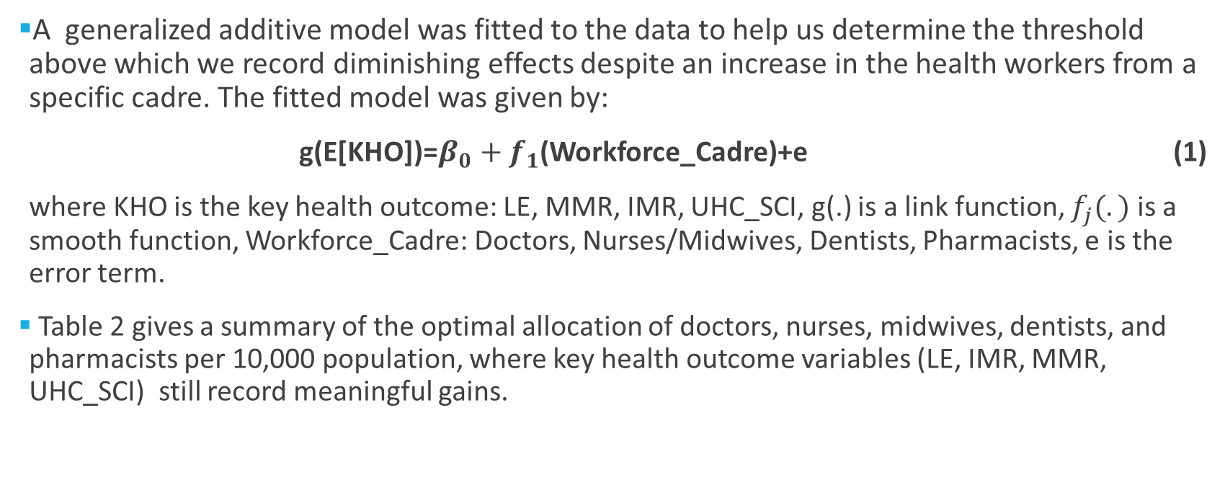
Effect of Health Workforce Density on Key Health Outcomes
A generalized additive model was fitted to the data to help us determine the threshold above which we record diminishing effects despite an increase in the health workers from a specific cadre. The fitted model was given by:
g(E[KHO])=$β_{0}+f_{1}$(Workforce_Cadre)+e (1)
where KHO is the key health outcome: LE, MMR, IMR, UHC_SCI, g(.) is a link function, $f_{j}(.)$ is a smooth function, Workforce_Cadre: Doctors, Nurses/Midwives, Dentists, Pharmacists, e is the error term.
Table 2 gives a summary of the optimal allocation of doctors, nurses, midwives, dentists, and pharmacists per 10,000 population, where key health outcome variables (LE, IMR, MMR, UHC_SCI) still record meaningful gains.

Slide 5
Optimal Health Workforce Density Allocations (Before Diminishing Returns)
Table 2 Optimal Health Workforce Density Thresholds per 10,000 population Required for Key Health Outcomes
Key Health Variable | Doctors | Nurses & Midwives | Dentists | Pharmacists
Life Expectancy (LE) | 30.52 | 29.25 | 2.57 | 5.15
Maternal Mortality Ratio (MMR) | 11.96 | 60.91 | 2.17 | 10.08
Infant Mortality Rate (IMR) | 31.61 | 46.35 | 2.85 | 7.96
Universal Health Coverage (UHC_SCI) | 12.69 | 47.44 | 3.16 | 7.88
Averages | 21.70 | 45.99 | 2.69 | 7.77

Slide 6
Optimal Health Workforce Density Allocations (Before Diminishing Returns)
Table 2 results demonstrate that key health outcomes such as life expectancy, maternal mortality, infant mortality, and service coverage improve sharply as workforce densities rise, but gains diminish above these thresholds.
It was discovered that for life expectancy to significantly increase, we need 31 doctors, 30 nurses and midwives, 3 dentists and 6 pharmacists per 10,000 population.
Similarly, for service coverage to increase, we need 13 doctors, 48 nurses and midwives, 4 dentists and 8 pharmacists per 10,000 population.
On the other hand, for maternal deaths to rapidly reduce, we need 12 doctors, 61 nurses, 3 dentists and 11 pharmacists.
Similarly, for infant deaths to be reduced, we need 32 doctors, 47 nurses, 3 dentists, and 8 pharmacists.
Therefore, on average across all health outcomes, we need around (22-32) doctors, (46-61) nurses, (3-4) dentists, and (8-11) pharmacists per 10,000 population.

